Slide 1

Topics
•
Inheritance
Basics
-
II
1
Object-Oriented Programming Using Java

Slide 2
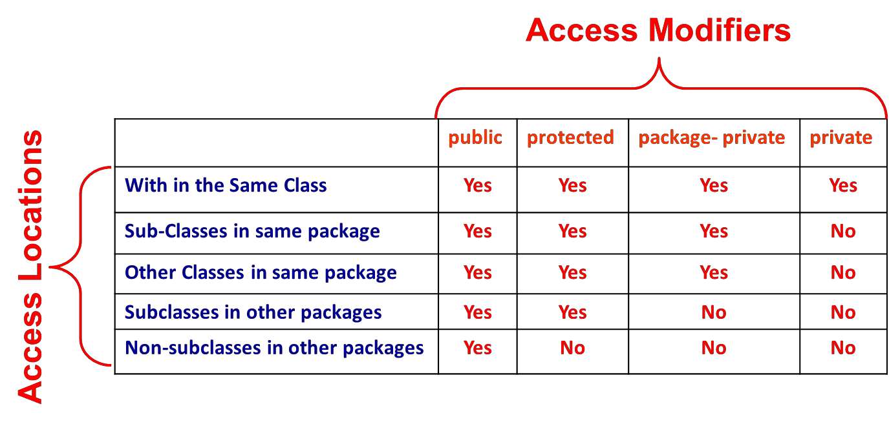
Inheritance Basics
•
Suppose A is super class of B. Then class B can inherit all the
features (Methods and Instance Fields) of class A except the private members.
•
Super and
Packages
Sub
Classes
May
Either
Belong
to
Same
or
Different
2
Object-Oriented Programming Using Java

Slide 3
Inheritance Basics ….
•
Whenever an instance of sub-class type is created, a super-
class
constructor is called first.
•
If a super-class constructor does not have any constructor
of its own OR has an un-parametrized constructor then it is
automatically called by JRE by using call super()
If a super-class has a parameterized constructor then it is
•
the responsibility
of the sub-class constructor
to call the
super class constructor by call
super(<parameters required by super class>)
Call to super class constructor must be the first statement in sub class constructor
•
3
Object-Oriented Programming Using Java

Slide 4
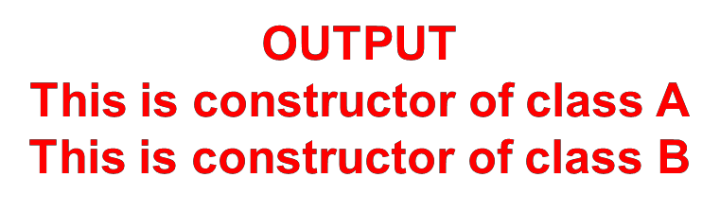
Extending Classes : Example 1
When super-class has an Un-parametrized Constructor
// File Name : Sample.java
class A
{
Call
to
a
Constructor
A()
{
Method of super-class
System.out.println("This is constructor of class A");
}
} // End of class A
class B extends A
{
B()
{
super();
System.out.println("This is constructor of class B");
}
} // End of class B
class Test
{
public static void main(String[] args)
{
B
}// End of Method
}// End of Class Test
b1
=
new
B();
4
Object-Oriented Programming Using Java

Slide 5
Extending Classes : Example 2
When a super-class has Either no or one Un-parametrized Constructor
// File Name : Sample.java
class A
{
A()
{
System.out.println("This is constructor of class A");
}
} // End of class A
class B extends A
{
B()
{
System.out.println("This is constructor of class B");
}
} // End of class B
class Test
{
public static void main(String[] args)
{
No super() statement
B
}// End of Method
}// End of Class Test
b1
=
new
B();
5
Object-Oriented Programming Using Java

Slide 6
Extending Classes : Example 3
When super-class has only a Parametrized Constructor
// File Name : Sample.java
class A
{
Results in Compile-Time Error.
A(int x, int y)
{
System.out.println("This is constructor of class A");
}
} // End of class A
class B extends A
{
B()
{
System.out.println("This is constructor of class B");
}
} // End of class B
class Test
{
public static void main(String[] args)
{
A
sub-class
constructor
super-class
does not call
constructor
B
}// End of Method
}// End of Class Test
b1
=
new
B();
6
Object-Oriented Programming Using Java

Slide 7
Extending Classes : Example 3
When super-class has only a Parametrized
// File Name : Sample.java class A
{
A(int x, int y)
{
System.out.println("This is constructor of class A");
Constructor
}
} // End of class A
class B extends A
{
B(int a, int b)
A
sub-class
constructor
must call a parameterized
constructor of super-class
{
super(a,b);
System.out.println("This is constructor of class B");
}
} // End of class B
class Test
{
public static void main(String[] args)
{
B
}// End of Method
b1
=
new
B();
}// End of Class Test
Note : super() statement must be the first statement in a sub-class constructor
7
Object-Oriented Programming Using Java

Slide 8
Extending Classes : Example 4
‘final’ classes cannot have sub-classes
// File Name : Sample.java final class A
{
A(int x, int y)
{
System.out.println("This is constructor of class A");
}
} // End of class A
class B extends A
{
B(int a, int b)
{
super(a,b);
System.out.println("This is constructor of class B");
}
} // End of class B
The
Code Will Result in Compile-Time
Error.
8
Object-Oriented Programming Using Java

Slide 9
Role of super Keyword
•
‘super’ Java keyword primarily used for two purposes
1.
To Call constructor method of super-class from a sub-class constructor
Syntax:
(i) super() ;
// if super-class has only one un-parameterized constructor
(ii) super(<parameters>); // if super-class has only one parameterized constructor
2.
To call a method of super-class in a sub-class method or to access an
instance field of super-class in sub-class
are similar
Syntax:
(i) super.<super-class-method()> ;
(ii) super.<super-class-instance-field>;
especially
when
their
names
9
Object-Oriented Programming Using Java

Slide 10
Role of
super
:
Example 1
// File Name : XYZ.java
class A
{
private int a;
// Constructor Method
A( int a)
{
this.a =a;
class B extends A
{
private int b;
// instance field
// instance-field
private double c; // instance field
B(int a,int b,double c)
{
super(a);
this.b=b;
this.c=c;
System.out.println("This is constructor of class B");
System.out.println("This is constructor of class A");
} // End of Constructor
// print Method void print()
{
System.out.println("a="+a);
} // End of Method
// Display Method void display()
{
System.out.println("hello This is Display in A");
} // End of Method
} // End of class A
}// End of Constructor Method
// show Method void show()
{
print();
System.out.println("b = “ + b);
System.out.println("c = “ + c);
}// End of Method
} // End of class B
Call to print() method of super-class
Can be Written as super.print()
Call to super-class
Constructor
10
Object-Oriented Programming Using Java

Slide 11
Role of super
:
Example
2
// File Name : XYZ.java
class A
{
protected
int
a
=
20;
//
instance-field
} // End
of class A
extends A
class
{
B
private
void show()
{
int
int
a
=
30;
a
= 50;
System.out.println(“
System.out.prinltn(“ System.out.println(“
}// End of Method
End of class B
a= “ +
a);
a= “+ this.a);
a = “+ super.a);
}//
11
Object-Oriented Programming Using Java

Slide 12
Role of
super
:
Example 3
// File Name : XYZ.java
class A
{
private int a;
// Constructor Method
A( int a)
{
this.a =a;
class B extends A
{
private int b;
// instance field
// instance-field
private double c; // instance field
// Constructor Method
B(int a, int b, double c)
{
super(a);
this.b=b;
this.c=c;
System.out.println("This is constructor of class B");
System.out.println("This is constructor of class A");
} // End of Constructor
// print Method void print()
{
System.out.println("a="+a);
}
// Display Method
void show()
{
System.out.println(“Hello This is Display in A");
}
} // End of class A
}// End of Constructor Method
// show Method
void show()
{
super.show(); System.out.println("b = “ + b); System.out.println("c = “ + c);
}// End of Method
} // End of class B
Call to show() method of super-class
Call to super class Constructor
12
Object-Oriented Programming Using Java

Slide 13
Thank
You
13
Object-Oriented Programming Using Java

